Slide 1



CARBON CAPTURE
WEEK 1
Different Types of Carbon Capture Technology and processes.

Slide 2

LECTURE 2

Slide 3

TOPIC OUTLINE
Introduction to Carbon Sequestration
Carbon Sequestration
Oceanic Sequestration
Terrestrial Sequestration
Geologic Sequestration
Call to action

Slide 4
INTRODUCTION TO CARBON SEQUESTRATION
- Human Impact on CO2 Levels: Human activities, such as deforestation, combustion especially burning fossil fuels, have increased CO2 levels in the atmosphere. CO2 level has increased from 280 ppm to over 380 ppm in the last 250 years.
- Consequences: This rise in CO2 causes global warming, leading to sea-level rise, extreme weather events, changes in precipitation, and ocean acidification. Sea level has increased by 8-9 inches in the past century.
- Need for Action: To mitigate these effects, strategies are needed to reduce CO2 emissions and remove CO2 from the atmosphere.

Slide 5
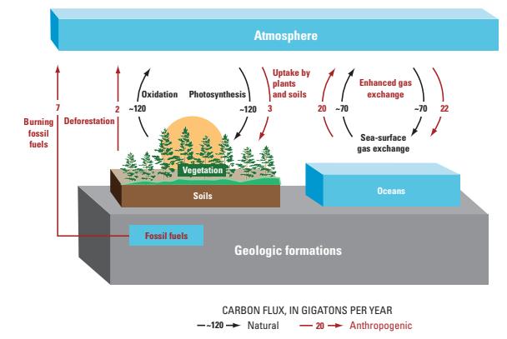
CARBON SEQUESTRATION
- Definition: Carbon sequestration involves capturing and storing CO2 to prevent it from entering the atmosphere. The term “carbon sequestration” is used to describe both natural and deliberate carbon, in Gigatons per year 1.5 Fossil-fuel CO2 release forest Net uptake Net non-forest uptake Net CO2 release 0 net flux of carbon as CO2 processes by which CO2 is either removed from the atmosphere or diverted from emission sources and stored in the ocean, terrestrial environments (vegetation, soils, and sediments), and geologic formations.
- Natural vs. Deliberate Processes: CO2 can be stored naturally (e.g., in plants, soils, and oceans) or through human efforts (e.g., geological storage).
- Current Balance: Natural processes can't keep up with human-caused CO2 emissions. The U.S. emits 1.6 gigatons of CO2 annually but only absorbs 0.5 gigatons.

Slide 6

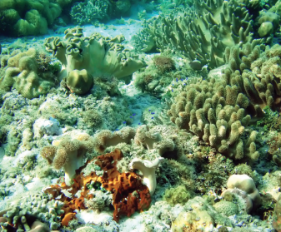
OCEANIC CARBON SEQUESTRATION
- Oceans naturally absorb about 2 gigatons of CO2 annually through chemical reactions. This uptake is not a result of deliberate sequestration, but occurs naturally through chemical reactions between seawater and CO2 in the atmosphere.
- While absorbing atmospheric CO2, these reactions cause the oceans to become more acidic. While planktons and coral reefs depend on carbonates. This absorption causes ocean acidification and degradation of carbonates and harms marine life like plankton and coral reefs.
-.The impacts of ocean acidification and deliberate ocean fertilization on coastal and marine food webs and other resources are poorly understood. Scientists are studying the effects of oceanic carbon sequestration on these important environments.

Slide 7
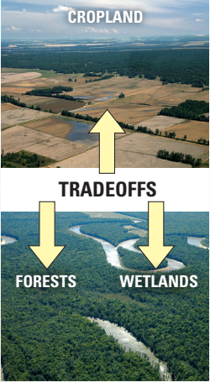
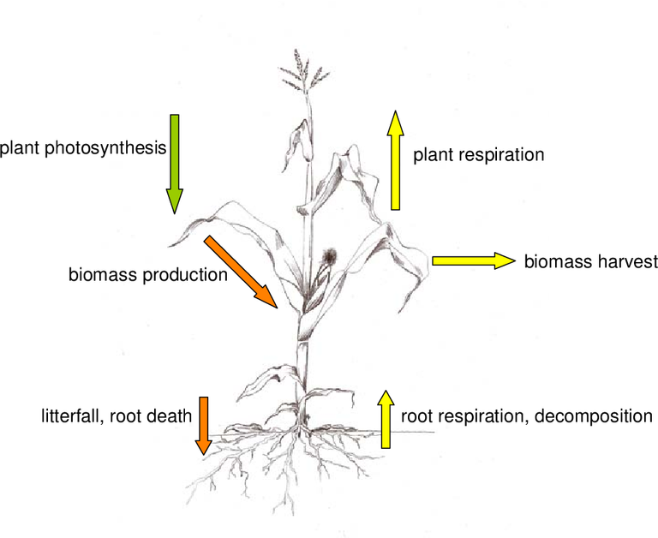
TERRESTRIAL CARBON SEQUESTRATION
-Terrestrial sequestration or even referred as biological sequestration is typically accomplished through forest and soil conservation practices that enhance the storage of carbon such as restoring and establishing new forests, wetlands, and grasslands or reduce CO2 emissions such as reducing agricultural tillage and suppressing wildfires.
- Current Impact: The net terrestrial uptake fluxes offset about 30 percent of U.S. fossil-fuel CO2 emissions, only a small fraction of this uptake results from activities undertaken specifically to sequester carbon.
- Limitations: Existing carbon storage is vulnerable to disturbances like fires, diseases, climate change and land use. The estimate that sequestration required for the US might be about 32 Gigatons of forest and 7 gigatons of soil which is practically impossible as it would require a large percentage of US population to agriculture.

Slide 8
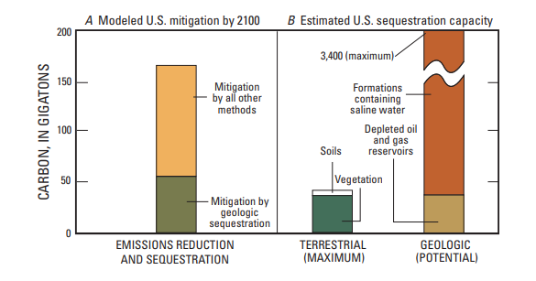
GEOLOGIC CARBON SEQUESTRATION
- Geologic Carbon sequestration Involves capturing CO2 from sources like power plants and storing it underground in rock formations.
- Potential and Challenges: This method has a high potential capacity but requires careful management to prevent leaks and environmental issues.
- USGS Role: The USGS provides crucial data to help develop effective carbon sequestration strategies while minimizing environmental impacts.

Slide 9

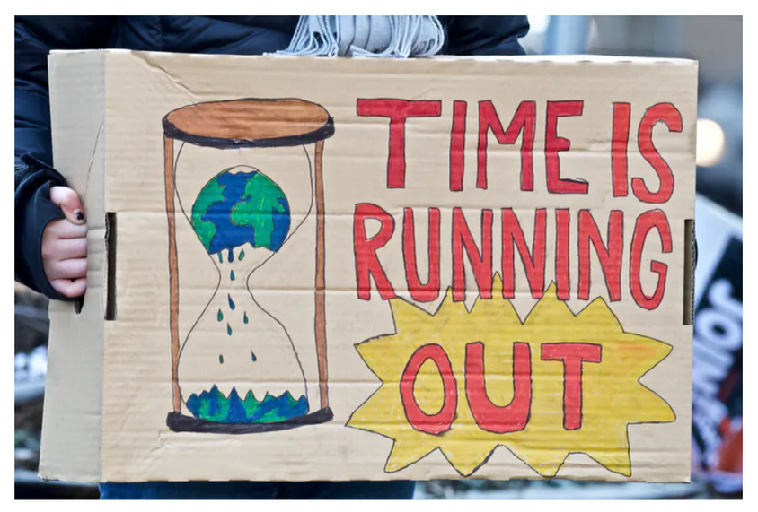
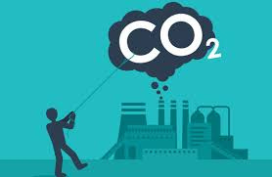
- Urgency: Immediate actions are required to mitigate climate change impacts. Future CO2 emissions need significant reduction.
- Comprehensive Approach: Stabilizing atmospheric CO2 will need a mix of energy changes and carbon management strategies.
- USGS Contribution: The USGS continues to research and provide information to guide decisions on carbon sequestration and climate change mitigation.
CALL TO ACTION

Slide 10
THANK YOU

